Slide 1

Foster Hospitality Group
Cost Benefit Analysis
December 20, 2021

Slide 2
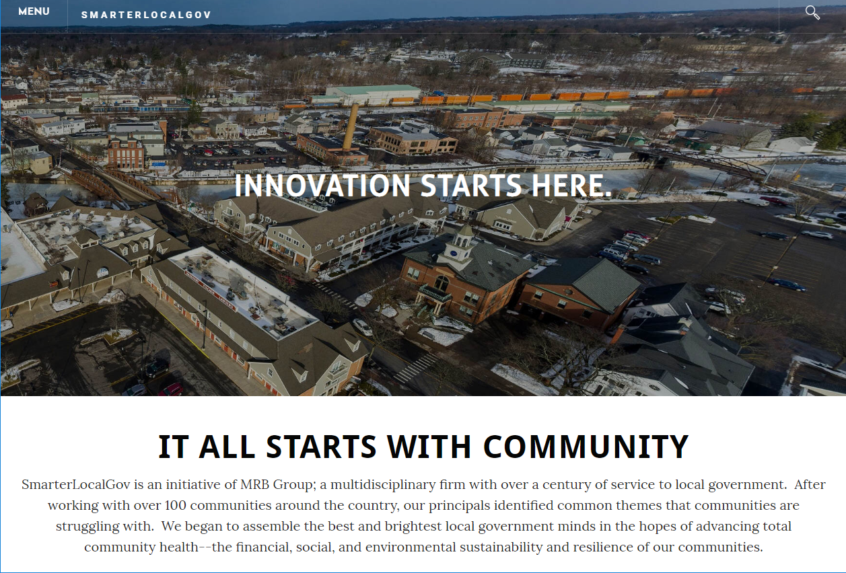

MRB Group and
SmarterLocalGov
MRB Group has been serving local governments for nearly a century as engineers and architects.
SmarterLocalGov was established in 2010 as the firm’s local government management arm.
Today, we support local governments across Upstate New York in their management, community, and economic development needs.

Slide 3

SmarterLocalGov Team
25 States, 300+ Studies
  ESD (x5)
  NYPA (x2)
  NYSERDA
  Louisiana, Vermont
  Amazon
  Lowes
  FedEx
  Volvo
Types of Studies
  Manufacturing
  High-tech
  Land development
  Housing
  Affordable housing
  Downtowns
  Industry-wide
  Policy-specific
Michael N’dolo
Michael is our Director of Economic Development. He has decades of experience in strategic economic development and is a nationally-recognized expert in economic and fiscal impact analysis.

Slide 4
agenda
Test of Reasonableness Findings
Cost Benefit Analysis Report

Slide 5
Test of Reasonableness

Slide 6
Test of Reasonableness
What is a “Test of Reasonableness”
Is the incentive necessary for the deal to be successful?
Is the proposed abatement too generous?
What do we test?
Debt Service Coverage Ratios (DSCR)
Pre-tax cash flow internal rate of return (IRR)

Slide 7
Test of Reasonableness
How did we conduct the analysis?
Analyzed the project’s overall budget, the construction budget, employment counts, stabilized operating revenues, and projected EBITDA.
Analyzed the capital structure of the deal, financing terms and conditions, and a profit-and-loss summary.
Discussions with the developer team.
Benchmarking against market data.

Slide 8
Test of Reasonableness
What are some of the data you benchmarked?
Average Daily Rate (ADR)
Revenue per Available Room (RevPAR)
Occupancy rate
Cost-of-goods-sold (COGS)
Financing terms and conditions
Also examined:
Incentives requested from IDA and other sources

Slide 9
Test of Reasonableness
RealtyRates.com “Investor Survey” provided the following data regarding the market’s “Equity Dividend Rates”: rates ranged from a minimum of 7.83% to a maximum of 18.11% with an average of 12.46%. It also listed the current cap rate for such properties at 9.44%.
We modeled the return-on-equity of the project by estimating cash flows to/from the equity investor(s) with a hypothetical exit in year 5.
We then recommended, after discussions with the Agency, an adjustment to the Developer’s proposed PILOT exemption schedule.

Slide 10
Test of Reasonableness
We find that the Applicant’s requested assistance, including the sales tax exemption, the mortgage recording tax exemption and the PILOT abatement schedule, as amended, provides the Developer a reasonable, risk-adjusted return and the Project’s DSCR is adequate for financing purposes.

Slide 11
CoSt-BENEFIT Analysis: Economic Impacts

Slide 12
CoSt-BENEFIT Analysis: Economic Impacts

Slide 13
CoSt-BENEFIT Analysis: PILOT SCHEDULE

Slide 14
CoSt-BENEFIT Analysis: PILOT
Value of PILOT Abatement
Property is currently tax exempt and therefore generates no tax.
The PILOT abatement will generate $3.78 million.
Most conservative estimate of “cost” is $4.51 million. This is the value we used in the analysis and for the Cost-Benefit ratio.
However, the property has an as-of right to a 485(b) abatement. When compared to the 485(b), the PILOT abatement “cost” is $3.26 million.

Slide 15
CoSt-BENEFIT Analysis: Summary of Fiscal Impacts
Notes:
The County keeps 73.616% and distributes 26.384% to cities, towns, and villages. The three cities receive 32.525% of the 26.384% broken down as follows: Newburgh 43.883%, Middletown 42.696%, and Port Jervis 13.421%. The towns and villages receive 67.475% of the 26.384% based on population, except for the Village of Highland Falls, where distribution is based on the ratio of property value to the entire Town of Highland.
So: Newburgh = ~12% (11.578%)

Slide 16
CoSt-BENEFIT Analysis: Summary of Fiscal Impacts

